Slide 1
JCLC 2020
31 May- 5 June

Slide 2
Intro
31May-5 June
Cadre: MSG Ross and MRS Ruthie Evers
Cadets will participate in a week of leadership and adventure training. Events will include wilderness Survival, first Aid, rappelling, Archery, Air Rifle Marksmanship, High and low ropes challenge course, Map Reading and Land Navigation, waterfront activities and leadership.
Cost is covered by the Army
rossj@jcschools.org

Slide 3
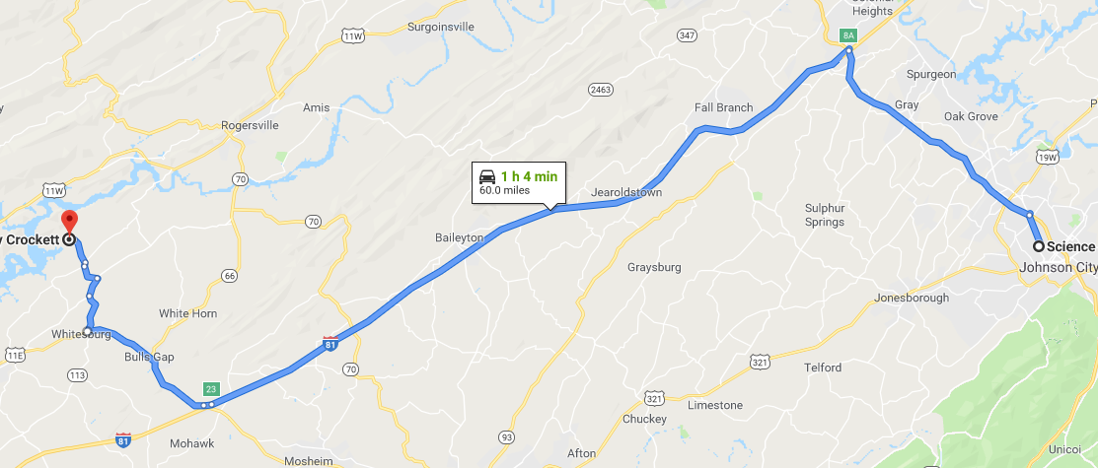
Directions from SHHS to Camp Davey Crockett
Leave Science hill driving North on Roan Street
Take I-26 West Exit 8 A to I-81 South toward Knoxville
Follow I-81 South to Exit 23,. Exit and turn Right onto 11E Follow for about 6.7 miles
Turn Right onto TN 113 beside Karl and Kathy’s Country Kitchen. Follow for 1.8 miles
Turn Right on TN 344 St Clair Rd. Follow for .9miles
Turn Left onto Thompson Rd and follow for 1 mile
Turn Slight Right onto Grassy Valley Rd and follow for .2 miles
Turn left onto Ninny Ridge Rd and follow for 1.2 miles
Turn left on Bingham Rd (this turn is in the middle of a sharp curve to the right) and follow for .3 miles
Turn Left into Camp Davey Crocket and follow the signs to Camp HQ.
Camp Address:
142 Scout Camp Rd, Whitesburg, TN 37891
Recommend printing directions before departure as there is limited cell service at the camp

Slide 4
Camp Guidelines page 1
Be on time for all activities
Take notes for the end of camp AAR
Ensure all cadets have a battle buddy at all times
Keep your camp free of trash and food. Animals will come into camp. (Stay away from all insects, snakes and other animals)
Do not eat in your cabin
Respect the camp staff and take good care of the camp
Announce your presence loudly if you must enter another school’s camp
Make up your bunk daily
Keep the latrines clean
Adults (18) and up will use the adult showers, all others will use the youth showers or individual showers
Cadets cannot bunk with Adults / Male and Female cadets must be in separate cabins
Two cadets per school will need to remain behind in the dining hall to help clean after each meal

Slide 5
Camp Guidelines page 2
Cadre will assist BSA staff in maintaining good order and discipline
Use your school chain of command, then the camp chain of command to resolve issues
Heat injuries are a real threat; hydrate before and after all training events
Camp fires are authorized, but must be adult supervised and completely out before going to bed or departing the camp site.
NO flames/fire/candles at all in the cabins
Use the latrines, not the woods
Stay in the prescribed uniform unless directed otherwise by Cadre (Canteens must be worn outside of unit camp sites)
Camp is a no salute area, but use proper greetings when addressing Staff or Cadre
NO one departs from camp without a cadre member and notifying the Camp Commandant first
Move to training in a military formation
Wear your heat injury, non swimmer, allergy, bands wrist bands at all times

Slide 6
Camp Guidelines page 3
Phone number at Camp: 423 235-4918 This phone is located in the camp office. This is the camp’s business phone and parents will not be able to talk to their children on this line unless it is an emergency. The staff member will take a message and deliver it to the unit. Of course, emergency messages will be delivered as soon as possible.
Use of cell phones by cadets, other than for pictures, is not authorized during the training day and will be limited by the cadre during the evening. Less is more!

Slide 7
Drop Off and Pick up Procedures
Arrive 1330 on 31 May
Report to the HQ shed
Drive equipment to camp site and drop off
make contact with MSG Ross or MRS Evers
Provide written instructions for medications along with the appropriate quantity of medications if required
Wear swim trunks/ suit under clothes when arriving
Pick up 5 June After awards ceremony
Report to the HQ shed
Note authorizing someone to pick up cadet if parent or guardian is not present
make contact with MSG Ross or MRS Evers
Cadets will not be released to anyone other than parent or guardian without prior written consent
Come watch your cadets compete on friday

Slide 8
2020 JCLC
Alternate Camp
Camp Davy Crockett Training Schedule
Evening Dining Order
Navy
U5
U4
U3
U2
U1
Sunday
Registration 1200 - 1400
Confirm Opening Report Numbers
Set up camp
Camp Orientation 1300-1600
Swim test 1300-1600
First formation and flags (U1) 1700
Dinner* 1730
*Safety Briefings (Rifle, Archery) 1830
Leader Meeting Immediately after Safety Briefings
Taps 2230
Leaders
Must
Ensure
Cadets and
Chaperones
Hydrate
Well
Every Night!
1. Scout guides will meet school rep at registration
2. Registration includes turning in:
a. Venture Scout registration forms
b. Verifying payment plan
c. Physicals / Mandatory Forms /Medical Issues
d. Unit Roster Verified for Opening Report
e. Verify Camp Site Location
f. Turn in Air Tanks for Range use
U1 TW, CHS, Grundy
U2 Jefferson & WHS
U3 Greene & BHS
U4 MHS & Corbin
U5 TNHS, SHHS
Notes:
Thomas Walker HS
Grundy HS
Cherokee HS
Science Hill HS
Tennessee HS
Middlesboro HS
Greeneville HS
Harlan Co. HS
Whitley Co. HS
Corbin HS

Slide 9
Friday Competition Schedule
2020 JCLC
Alternate Camp
Camp Davy Crockett Training Schedule
Dining Order
U1 TW, CHS, Grundy
U2 Jefferson & WHS
U3 Greene & BHS
U4 MHS & Corbin
U5 TNHS, SHHS
U1 - Flags
U2 – Store Area
U3 - HQ Bathhouse
U4 - Pool Latrine
U5 – Chow Hall Area
Morning | Lunch | Evening
U3 | U3 | U5
U1 | U5 | U4
U5 | U4 | U2
U4 | U2 | U1
U2 | U1 | U3
0530-0630 PT
0700-0715 Flags Field
0715-0815 Breakfast
0900-1200 (Competition Prep) or Archery / Tower / Pool / Trading Post
1215-1230 Lunch Formation at Flags Field
1230-1330 Lunch in the dining hall
1400-1700 Competitions
  1400-1430 Canoe Race (All units at the same time)
  1430-1630 Squad Drill / Rope Bridge ( Units 1-3 at Squad Drill / Units 4-5 at Rope Bridge 1430-1530, then swap)
  1500-1530 Water Survival (All units at the same time)
  1500-1700 Tomahawk Throw Units 1-3 at Tomahawk and 4-5 at Survival Skills (Complete and swap) (Co-located)
  1700-1745 Tug-o-War (All units in formation at Flags Field)
1745-1830 Flag Assembly and Awards Ceremony
1840-UTC Cookout / Activities
1915-UTC AAR
2130 Cadets in campsites
2300 Taps
Competitions: Sponsor
Rope Bridge (Middlesboro)
Water Survival (Grundy)
Tug o War (Greene)
Squad Drill (Science Hill)
Canoe Race (Jefferson)
Tomahawk Throw (Whitley)
Survival Skills (Corbin)
Rifle / Archery (BSA Range Personnel)
NOTE: for fun day activities, schools may break up into two groups, accompanied by a cadre member, and go to the training of their choice.
UNIFORM FOR THE TRAINING DAY IS: ACU / Boots and Hat / Water bottle or Canteen (Evening formation FUN-DAY uniform is Cadre select)
UNIFORM FOR COMPETITIONS IS: Unit PT uniform with water container or as specified by the competition rules.
Notes:
The Survival Skills competition will be a round robin event. A unit will start at one of the 3 sites and rotate from one site to the other. Points will be given for accomplishing tasks at each site. The competition will include the following:
Site 1. Build a Fire.
Site 2. Splint a Broken Bone and Apply a pressure bandage
Site 3. Build a poncho shelter
NOTE: Points will be given for completing each event based on a checklist. Each unit (2 schools) will start at a different location. Each school can enter one 3 person team. Penalties will be assessed for failure to complete the site task within the time allotted. Score sheets will be carried by the team from site to site.

Slide 10
56
Knox & Harlan
24
Grundy
32
SWP
32
32
MHS & Breathitt
Greene
48
64
Jefferson Co.
TW & Cherokee
24
Corbin
32
32
Science Hill
32
TN HI

Slide 11
Living Conditions
Cadets will live in cabins or tents that sleep 4 persons to a room
Male and Females will share a campsite but have separate cabins and hygiene facilities
Bring sunscreen, insect repellent will be needed
Shower shoes are a requirement
sleeping pads are recommended
Bring a pillow and sleeping bag or blankets
Cadets will Be provided 2 hot meals daily in the dinning facility and a bagged lunch

Slide 12

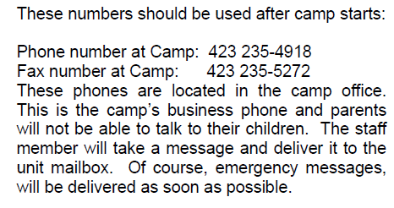

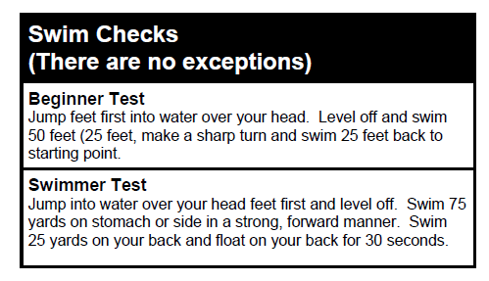
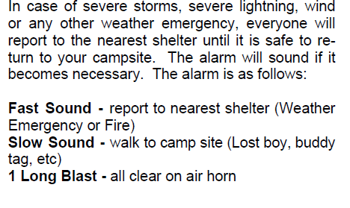
IMPORTANT BSA INFORMATION
Cadets that identify as non-swimmers will not take a swim test nor be permitted to participate in swimming events beyond instructional swimming classes.

Slide 13
Packing list
Brought from home:
Provided By JROTC:
OCPs/ with cap (no berets)
Boots
Belt
Socks
Lbe (belt, suspenders-first aid pouch, butt pack)
Canteens with cover and cup
Brown t-shirts
Duffle bag
Poncho
Wet weather paRKA
SLEEPING CLOTHES
FLASHLIGHT WITH EXTRABATTERIES
PERSONAL HYGIENE ARTICLES: deodorant, soap, tooth brush, tooth paste, shampoo, razors, and feminine products as needed
SUN SCREEN, INSENT REPELLENT FOOT POWEDER, NOTE PAD, PENCIL DISPOSABLE CAMERA
SLEEPING BAG OR SHEETS AND BLANKETS
PILLOW
SOCKS
MONEY (OPTIONAL. NOP MORE THAN $25
LOCK AND KEY FOR VALUABLES
Underwear
Sports Bras (female)
Shower shoes
Athletic shoes
Old shoes or water shoes for lake front
Athletic shorts and bn t-shirt for pt
Bath towels
Wash cloth
Civilian clothes (shorts pants, blue jeans (no holes), shirt, shoes)
Swim suit/trunks (females must have a one piece)
MONEY (LESS THAN $20)

Slide 14
Medication
Turn in all documentation to the School Nurse prior to 20 April
Medication must be in original package or bottle
If student requires over the counter medication Johnson City Schools Health Services Permission to Administer Over the Counter Medications form complete turned into the School Nurse.
Carry/Self Medication Form for prescribed antihistamine and epinephrine complete Permission to Administer over the Counter Medications Form must be complete. (physician signature required)
Provide medication to MSG Ross at drop off and provide only the dose required for cadet’s week of camp

Slide 15
Contraband items
No knives
No electronic devices (does not include gps, watches, or flashlights)
NO Tobacco/ vapor products
No firearms
Medication is not authorized unless conditions previously briefed have been met

Slide 16
QUESTIONS

